Slide 1


Slide 2
Scheduling

Slide 3
Main Points
Scheduling policy: what to do next, when there are multiple threads ready to run
Or multiple packets to send, or web requests to serve, or …
Definitions
response time, throughput, predictability
Uniprocessor policies
FIFO, round robin, optimal
multilevel feedback as approximation of optimal
Multiprocessor policies [also, fine vs. coarse grained]
Affinity scheduling, gang scheduling
Queueing theory [for your awareness; not responsible re exam]
Can you predict/improve a system’s response time?

Slide 4
Example
You manage a web site, that suddenly becomes wildly popular. Do you?
Buy more hardware?
Implement a different scheduling policy?
Turn away some users? Which ones?
[good or not-so-good example in 2020?]
How much worse will performance get if the web site becomes even more popular?

Slide 5
Analytical aside
Much mathematical opportunity (both straightforward and complex) that can be applied to characterize, predict different scenarios
We will consider qualitative comparisons of different approaches

Slide 6
Definitions
Task/Job
User request: e.g., mouse click, web request, shell command, …
Also: HPC simulation job, …
Latency/response time
How long does a task take to complete?
Throughput
How many tasks can be done per unit of time?
Overhead
How much extra work is done by the scheduler?
Different nuances in ~desktop, minimal embedded, big-job HPC
Fairness
How equal is the performance received by different users?
Predictability
How consistent is the performance over time?
Notes:
1. Minimize response time: elapsed time to do an operation (or job)
Response time is what the user sees: elapsed time to
echo a keystroke in editor
compile a program
run a large scientific problem
2. Maximize throughput: operations (or jobs) per second
Throughput is related to response time, but they're not identical -- for example, I’ll show that minimizing response time will lead you to do more context switching than you would if you were only concerned with throughput.
Two parts to maximizing throughput
a. Minimize overhead (for example, context switching)
b. Efficient use of system resources (not only CPU, but disk, memory, etc.)
What does CPU scheduling have to do with efficient use of the disk? A lot! Have to have CPU to make a disk request.
3. Fair: share CPU among users in some equitable way
Tradeoff: will argue you can get better average response time by making system less fair.
What does fairness mean?
Minimize # of angry phone calls? Minimize my response time?
Minimize average response time? We will argue fairness is a tradeoff against average response time; can get better average response time by making system less fair. Sort of like capitalism.
Anecdote: Response time has a lot to do with perceived effectiveness.
IBM keystroke experiment -- consistency is better than speed.
Might believe that since have PC's, CPU scheduling is less important -- usually, only one thing running at a time, for a single user. But! Face similar problems in networks -- how do you allocate scarce resources among users? Do you optimize for response time, throughput, fairness? In networks, fairness is often suboptimal.

Slide 7
First In First Out (FIFO)
Schedule tasks in the order they arrive
Continue running them until they complete or give up the processor
Example: memcached
Facebook cache of friend lists, …
On what workloads is FIFO particularly bad?
Notes:
Always happens to me -- you go to the store to buy a carton of milk, you get stuck behind someone with a huge basket? And insists on paying in pennies. Feature -- gives you time to read the National Enquirer. Computer science professor has space alien's baby.

Slide 8
Shortest Job First (SJF)
Always do the task that has the shortest remaining amount of work to do
Often called Shortest Remaining Time First (SRTF)
Suppose we have five tasks arrive one right after each other, but the first one is much longer than the others
Which completes first in FIFO? Next?
Which completes first in SJF? Next?
Notes:
Need to be careful: optimal wrt average response time.
Recall: only preemptive schedulers.

Slide 9
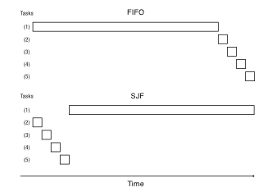
FIFO vs. SJF
Notes:
Now you can see why SJF improves average response time – it runs short jobs first. Effect on the short jobs is huge; effect on the long job is small.

Slide 10
Question
Claim: SJF is optimal for average response time
Why?
Does SJF have any downsides?
Notes:
Time to practice your CSE 311. Consider a hypothetical alternative policy that is not SJF, but that we think might be optimal. Because the alternative is not SJF, at some point it will choose to run a task that is longer than something else in the queue. If we now switch the order of tasks, keeping everything the same, but doing the shorter task first, we will reduce the average response time.
Downsides: starvation, and variance in response time. Some task might take forever!
Imagine a supermarket that used SJF – would it work?
What would you do if you went to the supermarket and they were using SJF? Clever person would go through with one item at a time…

Slide 11
Question
Is FIFO ever optimal?
Pessimal?
Notes:
Optimal = SJF
Pessimal = LJF

Slide 12
Starvation
Suppose you want to compare two scheduling algorithms
Create some infinite sequence of arriving tasks
Start measuring
Stop at some point
Compute average response time as the average for completed tasks between start and stop
Tradeoffs of this approach?
Notes:
SJF and FIFO would complete a different set of tasks – so they average response time isn’t directly comparable.
For example, in previous graphic – suppose you stopped at any point.
Worse, it tells you what you wanted to know – so you’d stop and say see!
Solution?

Slide 13
Round Robin
Each task gets resource for a fixed period of time (time quantum)
If task doesn’t complete, it goes back in line
Need to pick a time quantum
What if time quantum is too long?
Infinite?
What if time quantum is too short?
One instruction?
Notes:
Can we combine best of both worlds? RR approximates SJF by moving long tasks to the end of the line.

Slide 14
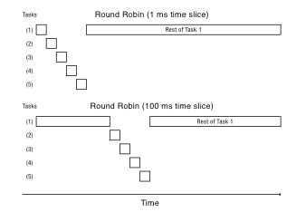
Round Robin
Notes:
Approximation depends on granularity

Slide 15
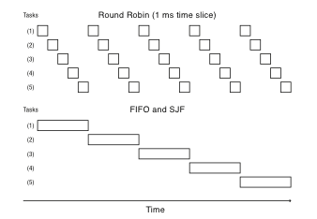
Round Robin vs. FIFO
Notes:
Everything is fair, but average response time in this case is awful – everyone finishes very late! In fact, this case is exactly when FIFO is optimal, RR is poor.
On the other hand, if we’re running streaming video, RR is great – everything happens in turn. SJF maximizes variance. But RR minimizes it.

Slide 16
Round Robin = Fairness?
Is Round Robin always fair?
What is fair?
FIFO?
Equal share of the CPU?
What if some tasks don’t need their full share?
Minimize worst case divergence?
Time task would take if no one else was running
Time task takes under scheduling algorithm
Notes:
Show of hands! After all, round robin ensures we don’t starve, and gives everyone a turn, but lets short tasks complete before long tasks.

Slide 17
CPU bound vs. I/O bound
WP: “a computer is CPU-bound (or compute-bound) when the time for it to complete a task is determined principally by the speed of the central processor: processor utilization is high, perhaps at 100% usage for many seconds or minutes.”
WP: “I/O bound refers to a condition in which the time it takes to complete a computation is determined principally by the period spent waiting for input/output operations to be completed. This is the opposite of a task being CPU bound.”

Slide 18
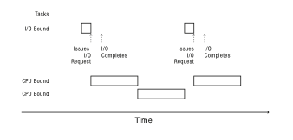
Mixed Workload
Notes:
One task does I/O repetively
The other tasks consume the CPU.
I/O task has to wait its turn for the CPU, and the result is that it gets a tiny fraction of the performance it could get.
By contrast the compute bound job gets almost as much as it would if the I/O task wasn’t there.
We could shorten the RR quantum, and that would help, but it would increase overhead.
what would this do under SJF? Every time the task returns to the CPU, it would get scheduled immediately!

Slide 19
Multi-level Feedback Queue (MFQ)
Goals:
Responsiveness
Low overhead
Starvation freedom
Some tasks are high/low priority
Fairness (among equal priority tasks)
Not perfect at any of them!
Used in Linux (and probably Windows, MacOS)

Slide 20
MFQ
Set of Round Robin queues
Each queue has a separate priority
High priority queues have short time slices
Low priority queues have long time slices
Scheduler picks first thread in highest priority queue
Tasks start in highest priority queue
If time slice expires, task drops one level

Slide 21
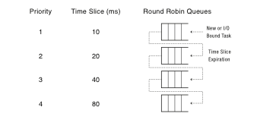
MFQ
Notes:
What strategy should you adopt if you knew you were running on an MFQ system?
Grad school: wrote an AI to play Othello. Both sides run on a uniprocessor – so if I could slow down the other task, I’d win! Periodically print a dot to the console screen (back when printing to the screen was I/O).

Slide 22
Uniprocessor Summary (1)
FIFO is simple and minimizes overhead.
If tasks are variable in size, then FIFO can have very poor average response time.
If tasks are equal in size, FIFO is optimal in terms of average response time.
Considering only the processor, SJF is optimal in terms of average response time.
SJF is pessimal in terms of variance in response time.

Slide 23
Uniprocessor Summary (2)
If tasks are variable in size, Round Robin approximates SJF.
If tasks are equal in size, Round Robin will have very poor average response time.
Tasks that intermix processor and I/O benefit from SJF and can do poorly under Round Robin.

Slide 24
Uniprocessor Summary (3)
Max-Min fairness can improve response time for I/O-bound tasks.
Round Robin and Max-Min fairness both avoid starvation.
By manipulating the assignment of tasks to priority queues, an MFQ scheduler can achieve a balance between responsiveness, low overhead, and fairness.

Slide 25
Multiprocessor Scheduling
What would happen if we used MFQ on a multiprocessor?
Contention for scheduler spinlock
Cache slowdown due to ready list data structure pinging from one CPU to another
Limited cache reuse: thread’s data from last time it ran is often still in its old cache
Notes:
Two problems:
Single lock on MFQ
Cache effects

Slide 26
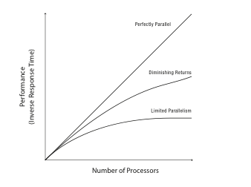
Parallel Program Speedup
Notes:
Is it possible to be above the perfect parallelism line? That is – more than N times faster on N processors?
Impact of overhead – creating extra threads, synchronization, communication that’s not needed in the single processor case. Overhead shifts the curve down, but still can be linear.
But we might also have non-perfect parallelism – e.g., for non-equal BSP tasks
Or if you have a single lock that’s contended.
For these last two cases, you’d rather give the system fewer processors and avoid time-slicing.

Slide 27
Queueing Theory
Can we predict what will happen to user performance:
If a service becomes more popular?
If we buy more hardware?
If we change the implementation to provide more features?

